Slide 1

Intro to Data Analysis & Visualization

Slide 2
Why Analysis?
Data Analysis is the process of systematically applying statistical or logical techniques to describe, illustrate, condense, and evaluate data.
Extract meaningful insights from raw information, uncover patterns or relationships, and support evidence-based decision-making
Resources and tools: R, Python, Excel, Tableau, Power BI…

Slide 3
Why Visualization?
Visualizing data helps us understand patterns, trends, and insights more easily.
But to tell the right story, we need to choose the right kind of plot.
Here's a quick guide to common plot types, what they show, and when to use each one.

Slide 4
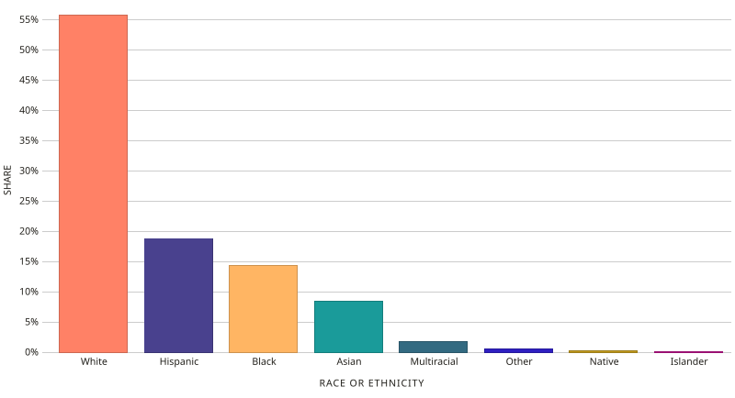
1. Bar Chart
What is it?
Bar Chart presents categorical or qualitative data using rectangular bars.
The height or length of each bar is proportional to the value fall into that category.
When to use it?
Use for visualizing single or multiple categorical variables on aggregated values
Great for highlighting group differences and ranking categories
Avoid if: Variable is continuous or quantitative
Source: Datawheel, CC0, via Wikimedia Commons

Slide 5
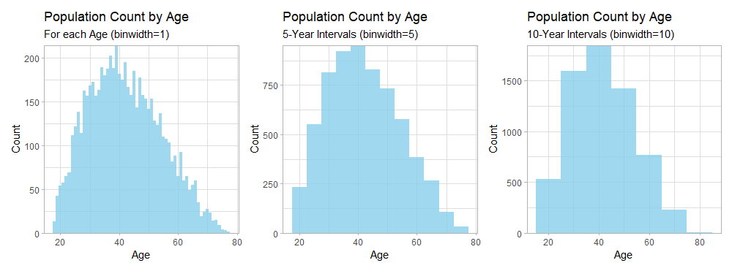
2. Histogram
What is it?
Histogram presents continuous or quantitative numerical data by splitting data into bins (ranges of values).
The height or length of each bin is proportional to the value fall into that range
When to use it?
Use for visualizing a single continuous variable on aggregated values
Great for understanding distributions, spread, skewness, and detecting outliers.
Avoid if: Variable is categorical or qualitative

Slide 6
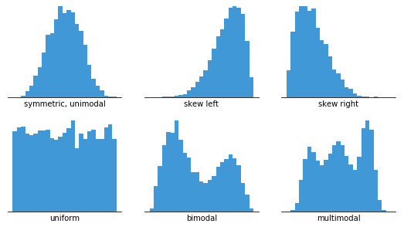
Extension - Distribution
Distribution describes how values of a variable are spread or arranged across its range. It shows the frequency or likelihood of different outcomes in a dataset.
Normal distribution is a bell-shaped, symmetric distribution where values near the mean are most frequent, and values farther from the mean are increasingly rare.
Left-skewed distribution (negatively skewed) has a longer tail on the left side, meaning most values are concentrated on the higher end, while fewer, lower values pull the mean to the left of the median.
Right-skewed distribution (positively skewed) has a longer tail on the right side, meaning most values are concentrated on the lower end, while a few higher values pull the mean to the right of the median.
Source: Yi, M. (2019). A complete guide to histograms. Atlassian

Slide 7
Extension - Distribution
Uniform distribution is a distribution where all values occur with equal or nearly equal frequency, meaning each outcome is equally likely and the data is spread evenly across the range.
Bimodal or multimodal distribution has two or more peaks (modes), meaning the data clusters around multiple values rather than one central value, which often suggests the presence of subgroups or distinct patterns within the dataset.
Source: Yi, M. (2019). A complete guide to histograms. Atlassian

Slide 8
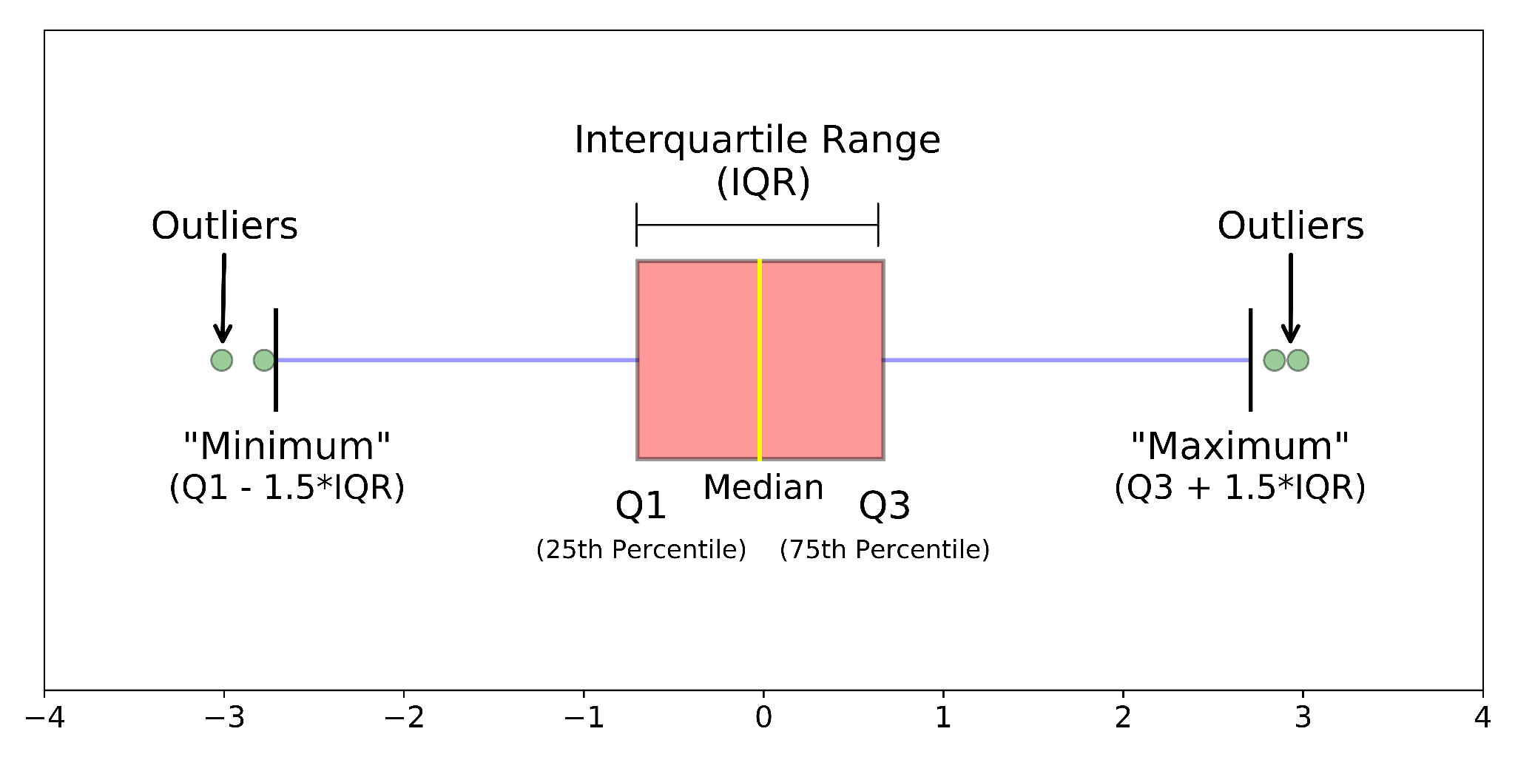
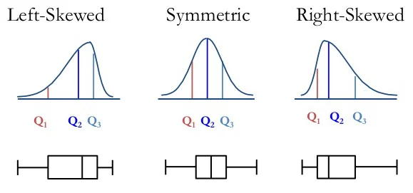
3. Boxplot
What is it?
Boxplot (or box-and-whisker plot) presents the distribution of a variable.
It shows the minimum, first quartile (Q1), median (Q2), third quartile (Q3), and maximum values..
When to use it?
Use for visualizing distribution of a single continuous variable
Great for understanding distributions, spread, skewness, and formally define outliers.
Avoid if: Data only contains a few observations.
Source: Galarnyk, M. (2019). Understanding Boxplots. KDNuggets.
Source: McLeod, S. (2025). Reading a Box and Whisker Plot. SimplyPsychology.

Slide 9
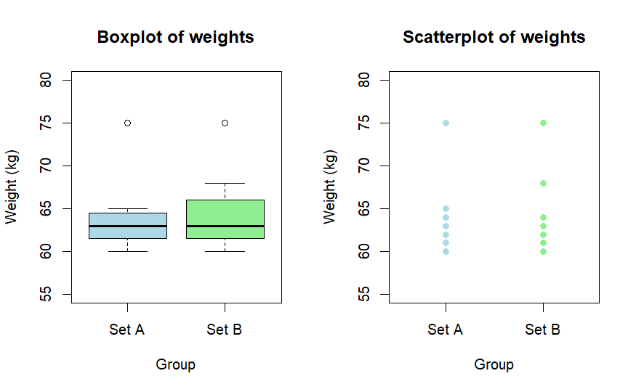
3. Boxplot
A | B
60 | 60
61 | 61
62 | 62
63 | 63
64 | 64
65 | 68
75 | 75

Slide 10
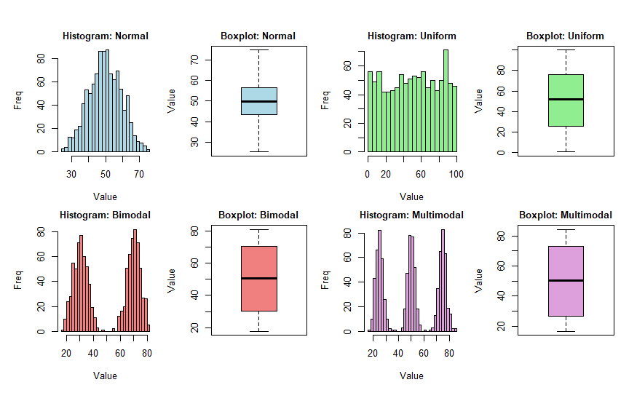
3. Boxplot

Slide 11
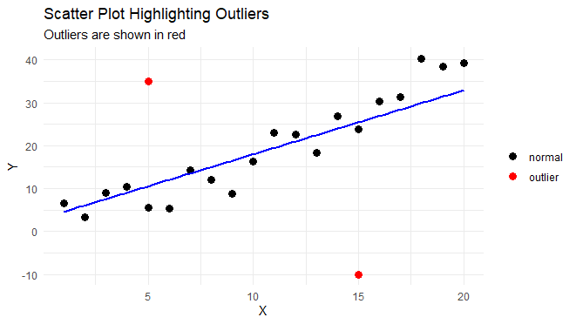
4. Scatter Plot
What is it?
Scatterplot displays the relationship between two numerical variables.
Each point represents an observation, with its position determined by values on the x- and y-axes.
When to use it?
Use for visualizing relationships between two continuous variables
Great for understanding correlations, clusters, trends, and detecting outliers.
Avoid if: Either variable is categorical

Slide 12
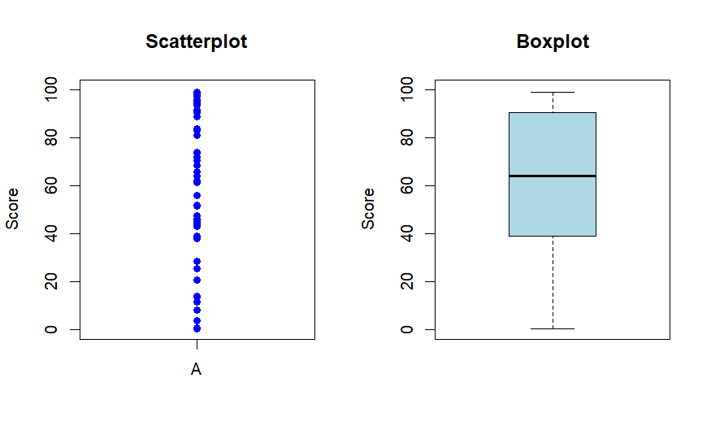
4. Scatter Plot

Slide 13
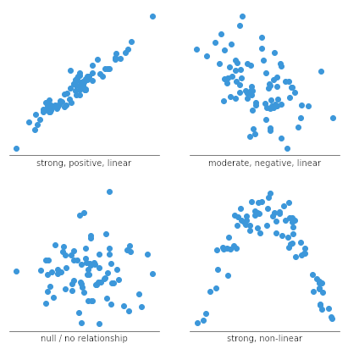
Extension - Correlation
What is it?
Correlation measures the strength and direction of a relationship between two variables.
A positive correlation means that as one variable increases, the other tends to increase.
A negative correlation means that as one increases, the other tends to decrease.
A correlation close to 0 suggests little or no linear relationship.
Linear Correlation is typically measured using the correlation coefficient (r), which ranges from –1 to +1.
It’s important to remember that correlation does not imply causation.
Source: Yi, M. (2019). A complete guide to scatter plots. Atlassian

Slide 14
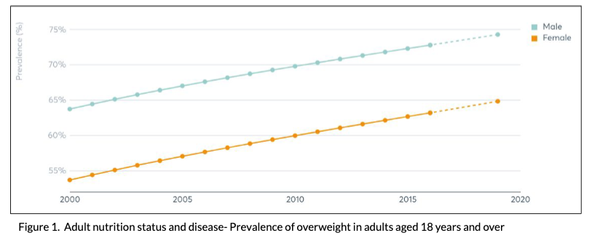
5. Line Chart
What is it?
Line Chart displays data points connected by straight lines, typically used to show trends over time.
It is a special class of Scatter Plot where the x-axis represents time, making the data ordered and sequential.
When to use it?
Use for visualizing ordered and sequential single or multiple continuous variables.
Great for understanding trends over time, temporal patterns, or comparing multiple time series.
Avoid if: Variables are not ordered or time-based.

Slide 15
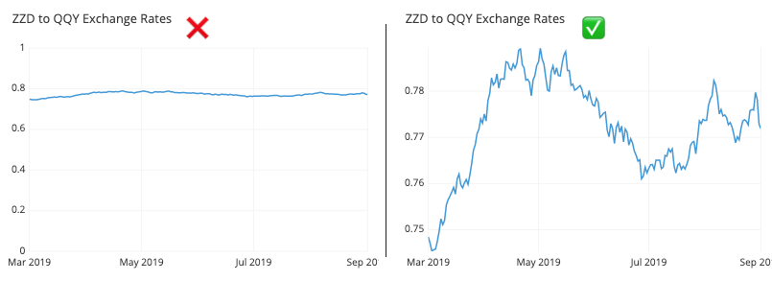
5. Line Chart
Source: Yi, M. (2019). A Complete Guide to Line Charts​​​​​​. Atlassian

Slide 16
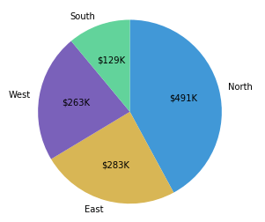
6. Pie Chart
What is it?
Pie Chart shows how a whole is divided into parts.
Each slice represents a category’s proportion of the total, making it easy to compare relative sizes.
When to use it?
Use for visualizing part-to-whole relationships.
Great for highlighting proportion differences and ranking categories.
Avoid if: Too many categories.
Source: Yi, M. (2019). A complete guide to Pie Charts. Atlassian

Slide 17
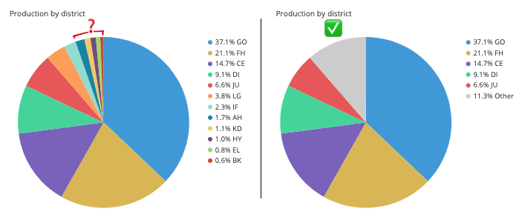
6. Pie Chart
Source: Yi, M. (2019). A complete guide to Pie Charts. Atlassian

Slide 18
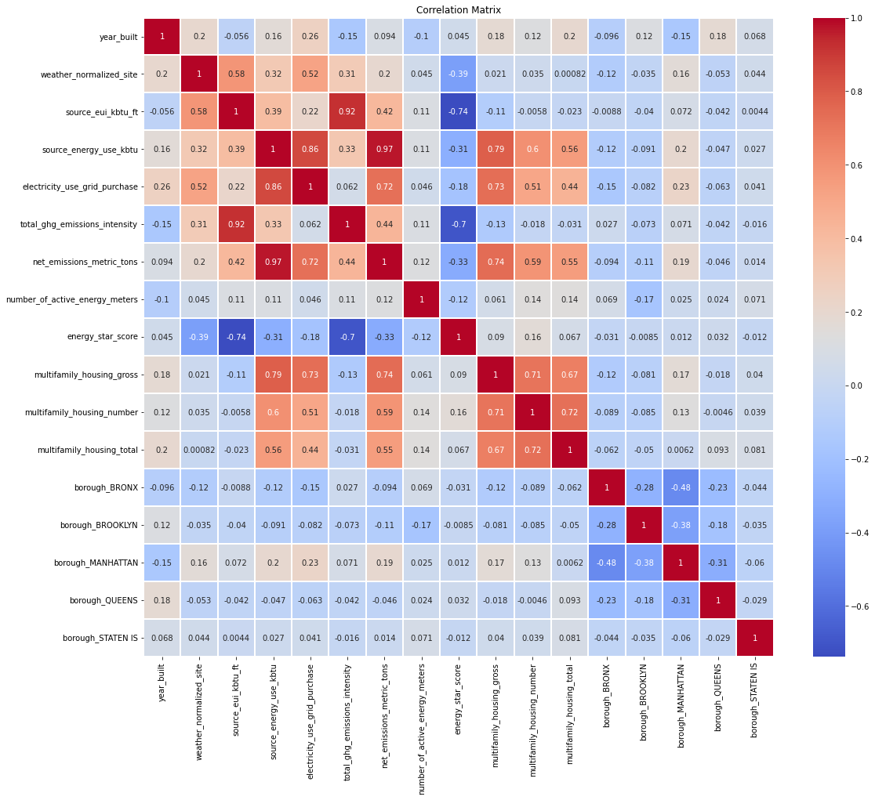
7. Heat Map (Correlation Matrix)
What is it?
Heat Map uses color gradients to represent the magnitude of values in a matrix or two-dimensional space.
Each cell is color-coded based on its value.
When to use it?
Use for visualizing correlations among multiple continuous variables
Great for understanding correlations, multicollinearity, and guiding feature selection.
Avoid if: Either variable is categorical.

Slide 19
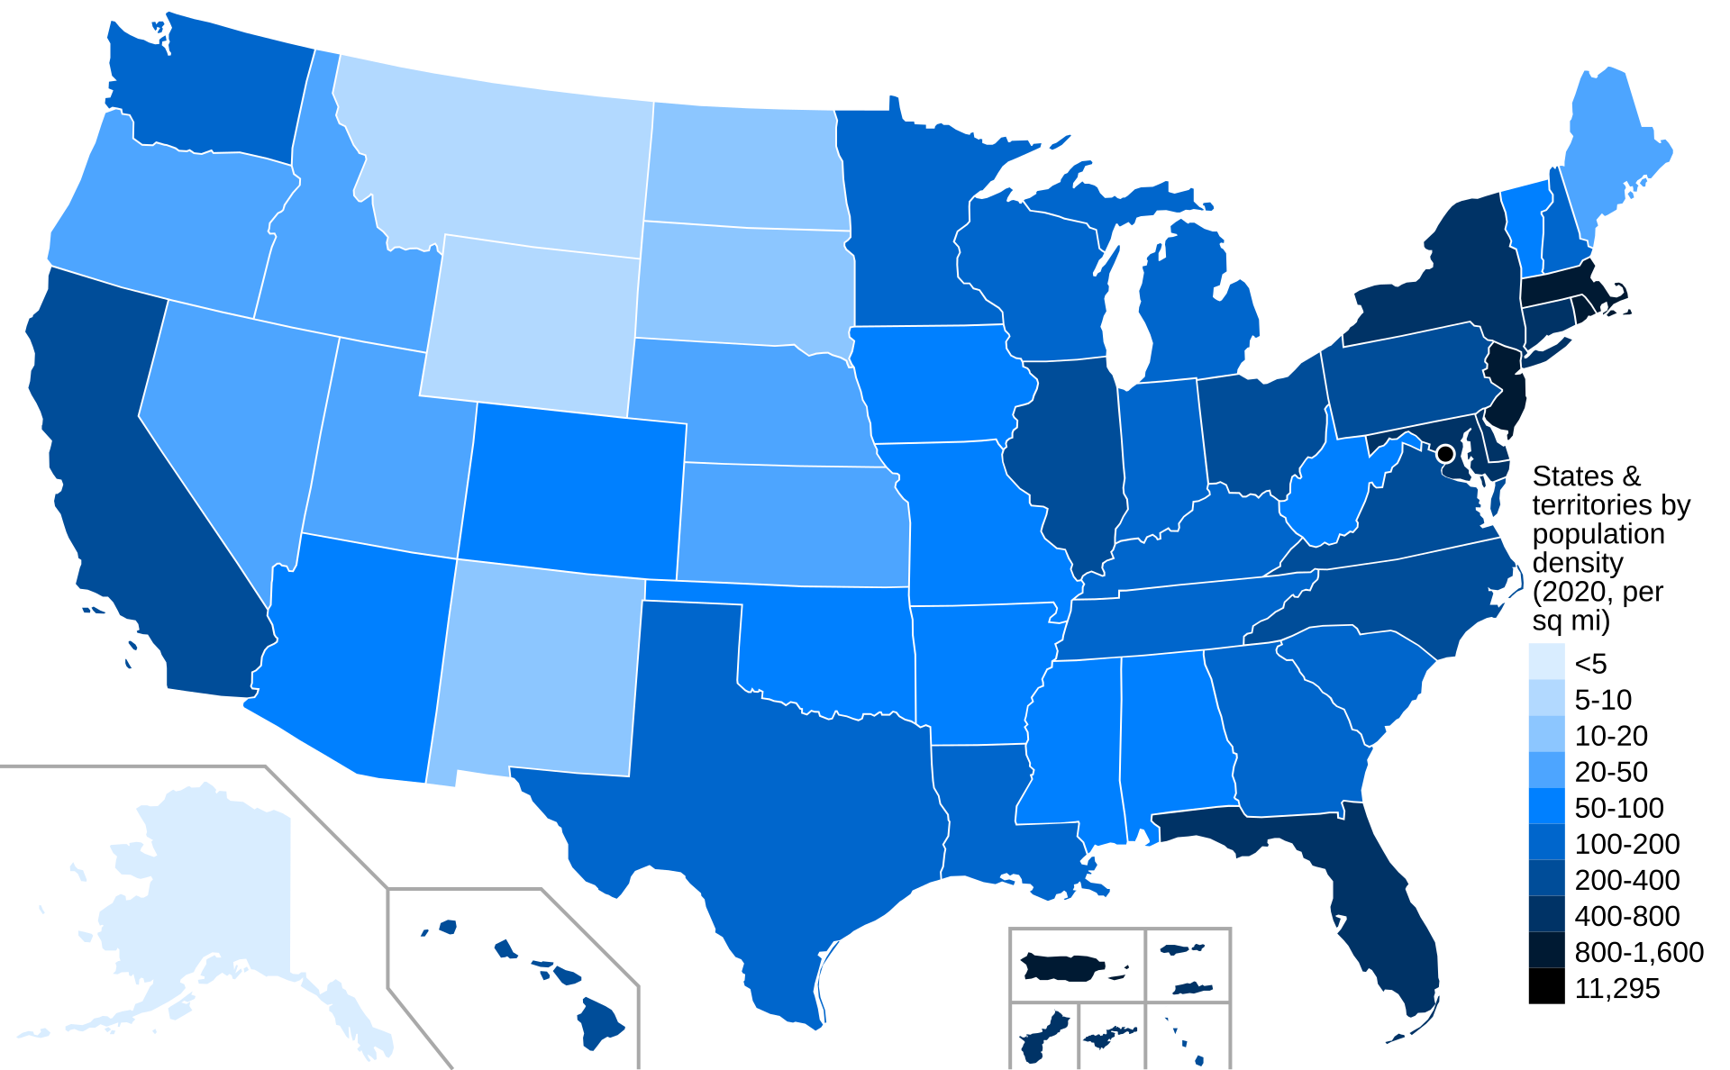
7. Heat Map
Source: Crossover1370, CC BY-SA 4.0, via Wikimedia Commons

Slide 20
Tips for DAV
https://libguides.wvu.edu/DAV
Set Working Directory Properly
Use consistent and descriptive file names
Ensure data types are correct
Use Library Resources : )

